Slide 1
Special topics Session 2 Al-Zahra university Maryam zim

Slide 2
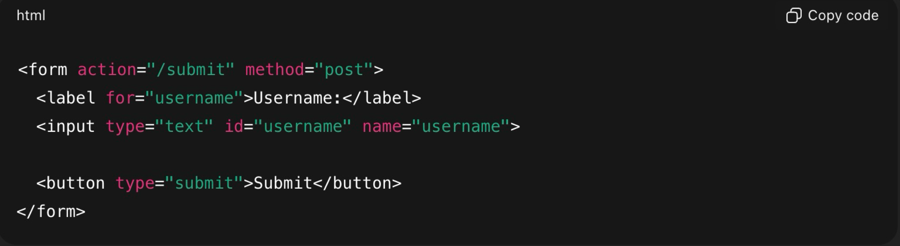
Form
Form is a html tag that collect user input and sends it to a server for processing.
Form contains form elements like:
Input , text area , button , etc .
For example:

Slide 3
Basic attributes of form :
Action : url where form data is sent.
Method: there are 2 types:
get : append the form data to the url .
less secure and this type has a size limited.
It’s the best for non-sensitive data like search query.
post: sends the form data in body of http request.
more secure and this type doesn’t have a size limitation.
It’s ideal for sensitive data and large amounts text.
3. Autocomplete: specifies whether a form should have autocomplete on or off.
When autocomplete is on, the browser automatically complete values
based on values that the user has entered before.

Slide 4
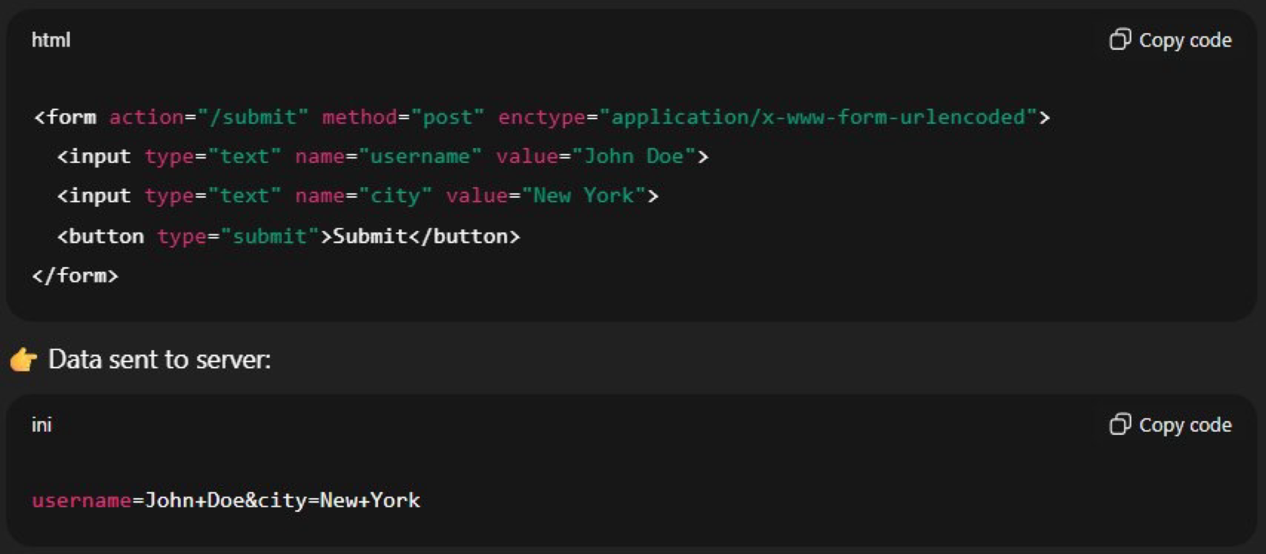
4. enctype: encoding type
It tells the browser how to package form data befor sending it to the server .
It only matter when you use method = “post”
There are to types of values :
-application/x-www-form-urlencoded
It’s default value. All characters are encoded before sent.
(each input is turned into key = value and pairs joined with & and spaces are converted to "+" symbols)

Slide 5
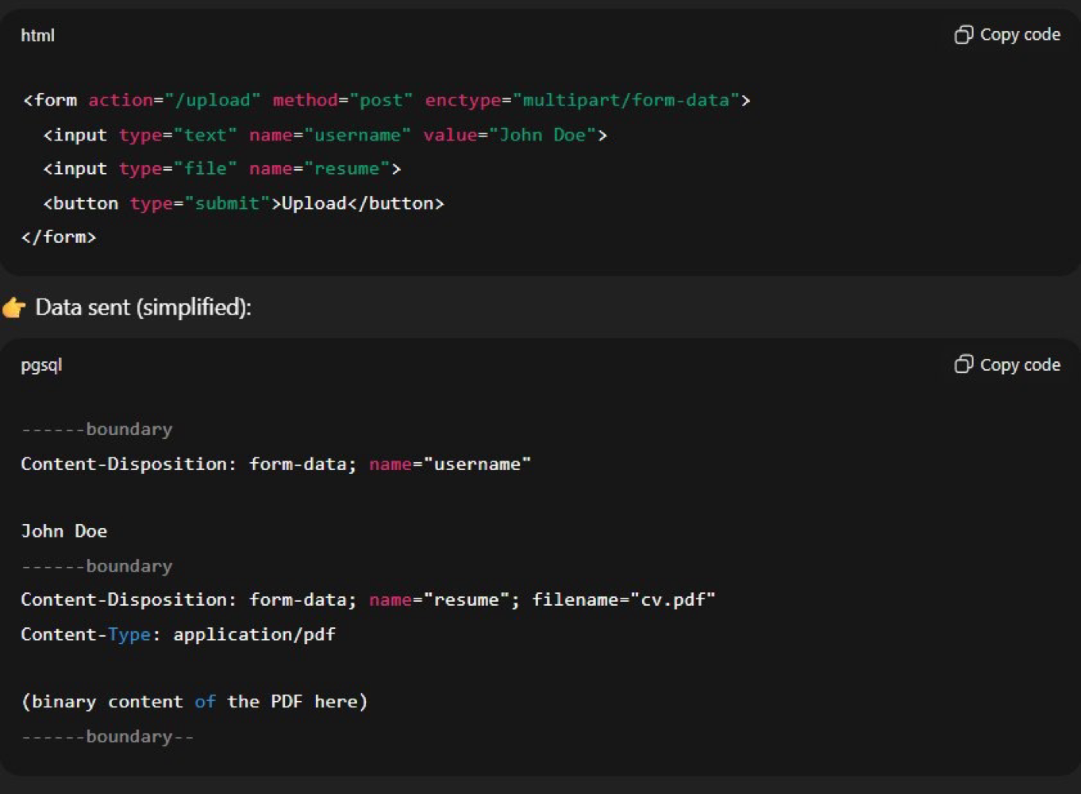
-multipart/form-data
This value is necessary if the user will upload a file through the form.
Form data splits into seprate parts and each part has its own headers and content.

Slide 6
Form Elemnts:
1-input: The <input> tag specifies an input field where the user can enter data and the most important form element.
The different input types are as follows:
<input type="button">
<input type="checkbox">
<input type="email"> required email format for example : maryamxiim@gmail.com
<input type="file">
<input type="number">
<input type="password"> hide input data with dots.
<input type="radio">
<input type="submit">
<input type="tell">
<input type="text">
<input type="url">. Required valid url , Example : https://

Slide 7
What is difference between tell and number type in input types?
Feature | type="tel" | type="number"
Semantic Meaning | Telephone Number. Indicates the input is a phone number (e.g., +1-555-123-4567). | Numerical Value. Indicates the input is a numeric value (e.g., age, quantity, price).
Input format | Accepts digits, hyphens, parentheses, and spaces (any characters valid in phone number formats). | Accepts only digits, and optionally a decimal point (.) and the negative sign (-), depending on locale.
validation | Does not enforce any specific phone number format validation. It just hints at the expected content. | Enforces that the value entered is a valid number. Non-numeric characters will usually prevent form submission or be ignored.
Spinners/Arrows | Does not show "up" and "down" spinner arrows. | Shows "up" and "down" spinner arrows on desktop browsers to increment/decrement the value.
Attributes | Can be used with the pattern attribute for client-side format validation (e.g., to enforce a specific 10-digit format). | Can be used with min, max, and step attributes to control the allowed range and interval of the number.

Slide 8
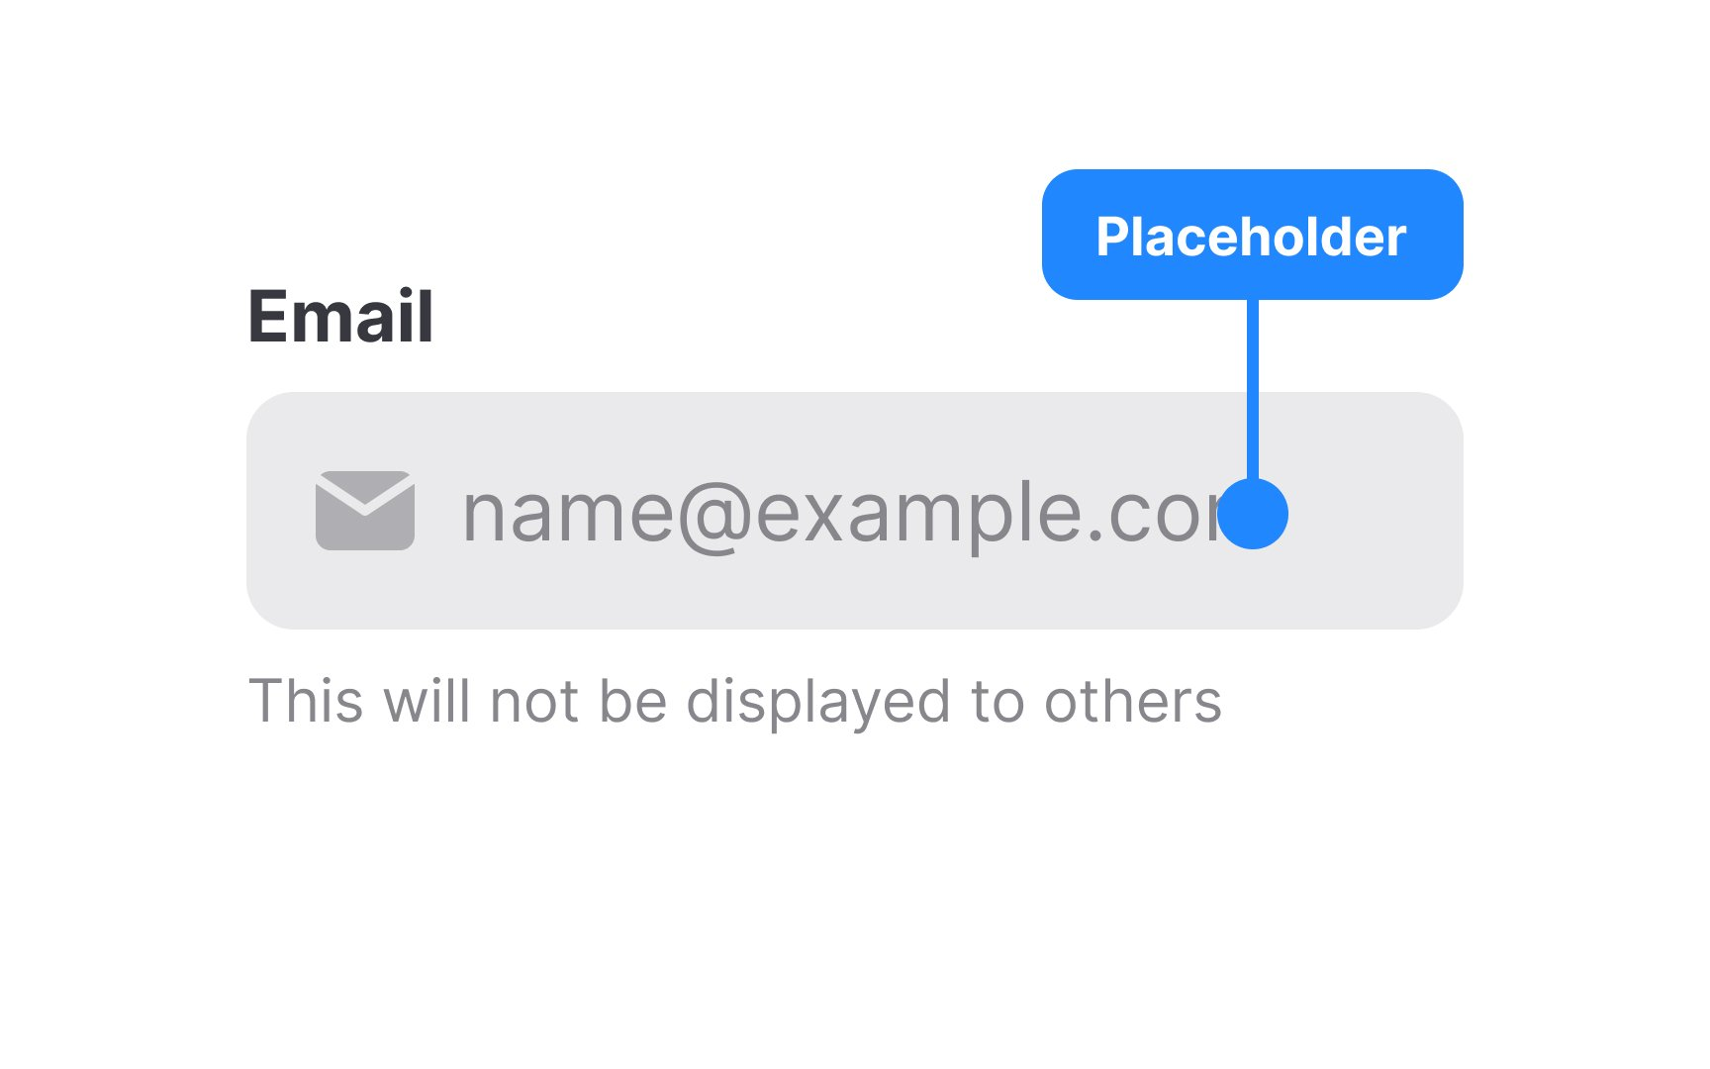
Attrs of input:
Name: The name attribute is used to reference elements in a JavaScript, or to reference form data after a form is submitted.
Autofocus : element should automatically get focus when the page loads.
Readonly
Disabled
Min & max: it’s for numeric and date to specify min and max acceptable value.
Placeholder: specifies a short hint that describes the expected value of an input field

Slide 9
What is difference between disabled and readonly attribute in input?
Feature | readonly | disabled
User interaction | User can focus (tab to) the element. The value cannot be modified by the user. | User cannot focus (tab to) the element. The value cannot be modified by the user.
Form Submission | The field's name and value are included when the form is submitted. | The field's name and value are not included when the form is submitted.
validation | Not subject to form validation (e.g., required attribute is ignored). | Not subject to form validation.
Spinners/Arrows | Does not show "up" and "down" spinner arrows. | Shows "up" and "down" spinner arrows on desktop browsers to increment/decrement the value.
Use case | Displaying a pre-filled value that the user must see but not change (e.g., a non-editable account ID or calculated total). | Temporarily deactivating a field until certain conditions are met (e.g., disabling the "Submit" button until all required fields are filled).

Slide 10
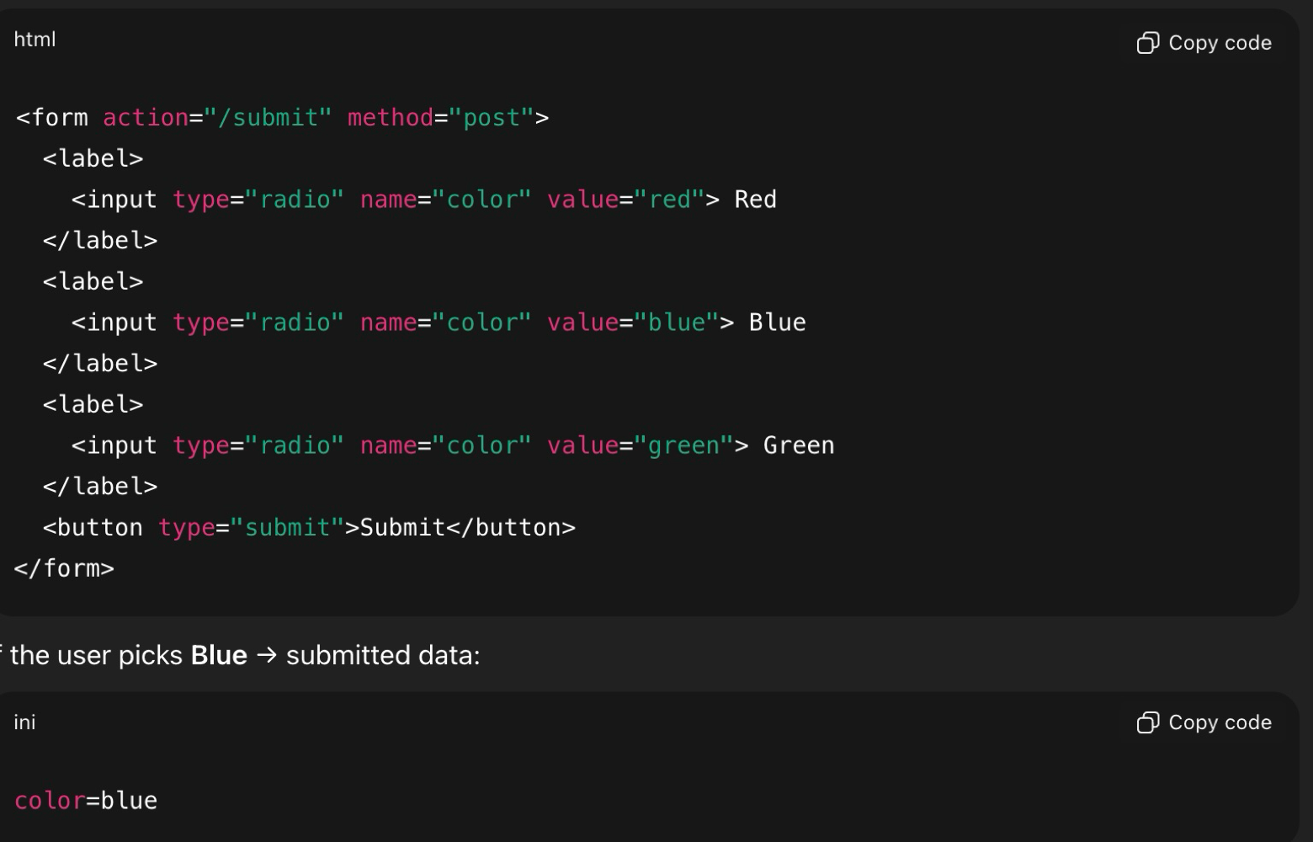
Form Elemnts:
1-textarea: The <textarea> tag used to create a multiple-line text .
Its attributes :
Name
Rows/cols : about width and height.
Placeholder
Maxlength: sets the maximum number of character a user can enter .
2-radio button : input element that let users select one option only form a group of choice.
Its attributes :
Name: Example radio grouped by their name attr. If multiple radio share same name , only one, can be selected at a time.
Please zoom in on the photo.

Slide 11
Form Elemnts:
2-radio button : Its attributes :
Value: the selected value is sent with form.
Checked : pre-selected an option
Disabled
3-checkbox : allows users to select multiple options independ.
Unlike radio button each checkbox works on its own.
Its attributes :
Value:
Checked
Disabled
Name
Tip: when the form is submitted , only the checked boxes are included.

Slide 12
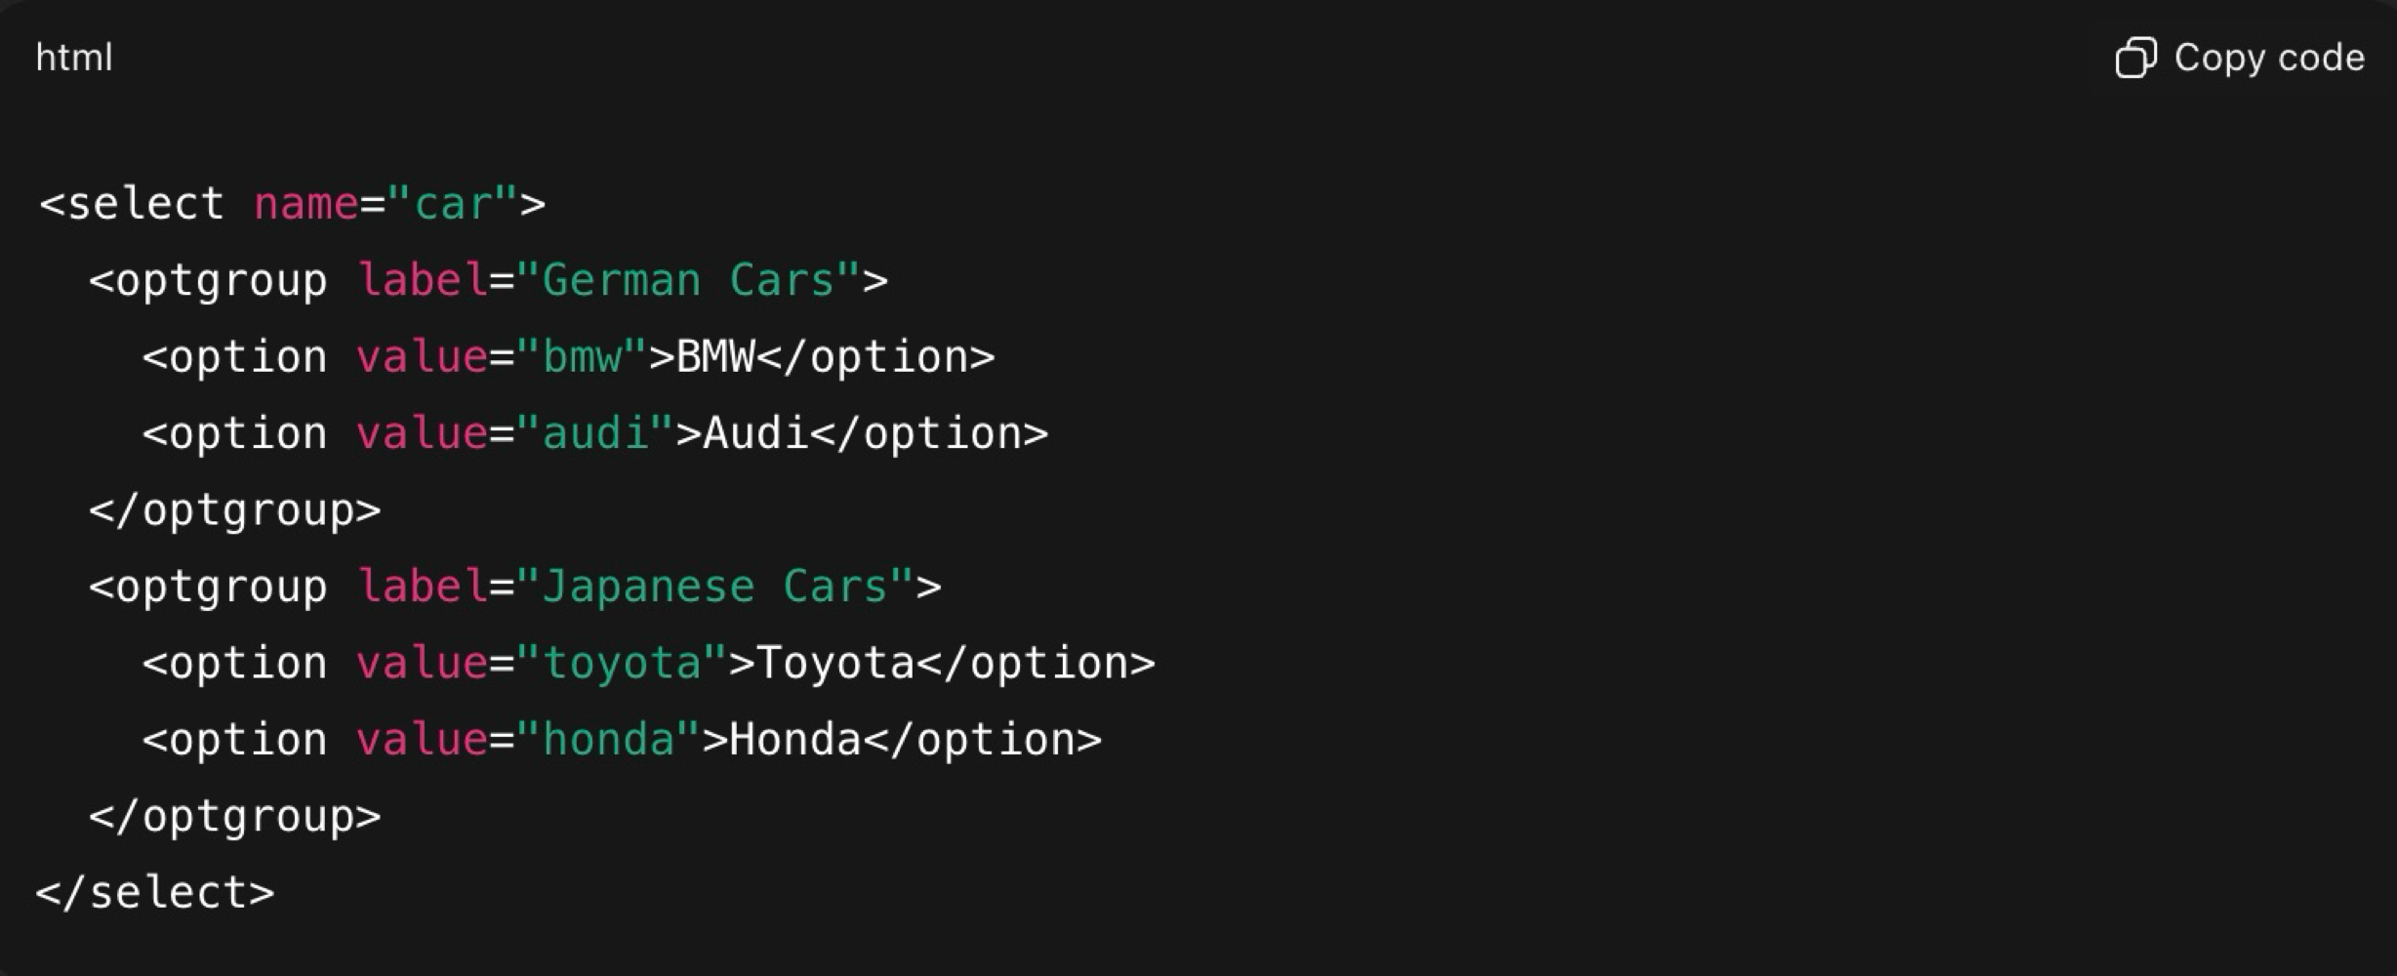
Form Elemnts:
4-select: the <select> element is used to create a drop-down list. And create with <select> element ans inside it <option> elemnts.
<select> attributes :
Name
Multiple: allows multiple option (with control key).
Size: how many options are visible without scrolling.
<option> attributes :
Value
Selected
disabled
Grouping options: you can group related options with <optgroup> tag

Slide 13
Form Elemnts:
5-button: The <button> element is interactive element that users can click to trigger an action.
It have 3 types:
Button : no action by default.
Submit: submit form data to server.
Reset: reset all form fields.
6-file: for upload file and it creats a browser button , so users can select one or more files from their device.
When form is submitted , the selected file are sent to the server.
It attributes:
Name
Accept: restrict allow file types.
its types:
image/* : all images
.pdf : only pdf file
.jpg , .png: only jpg and png file

Slide 14
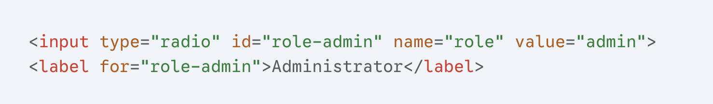
Form Elemnts:
file:
It attributes:
Name
Accept
Multiple: allow selecting multiple files.
Required
Disabled
Security note: browsers do not allow setting default value for file inputs.
Supporting element for input:
Label : provides a text description for an input .
Clicking the lable also focuses the input.
Link to input with for(match input id)

Slide 15
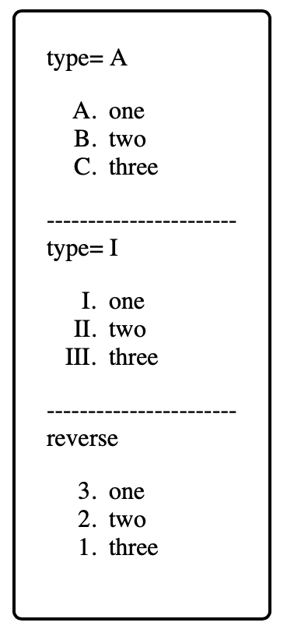
Lists:
A list is a way to group related items together in an organized structure .
Lists in html have containers and list item elements.
Types of list:
Ol : ordered list : The <ol> tag is used for lists where the order of the items is significant or meaningful.
Ul: uordered list: The <ul> tag is used for lists where the order of the items does not matter.
Their elements are <li> : list item
<ol> element :
displays items in a numbered sequence and each item inside <li> element.
Its attributes:
Type: changing numbering style (such as: 1, A , a , I , i)
Start: define starting number
Reversed: count down instead of up.

Slide 16
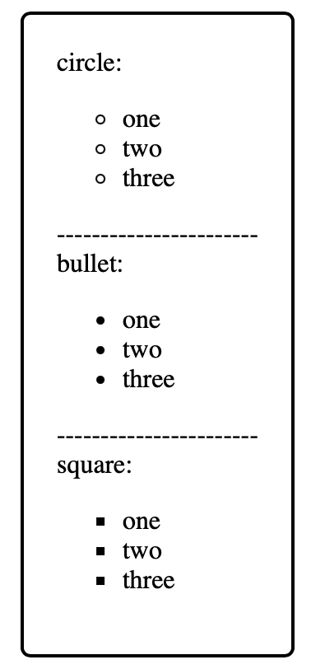
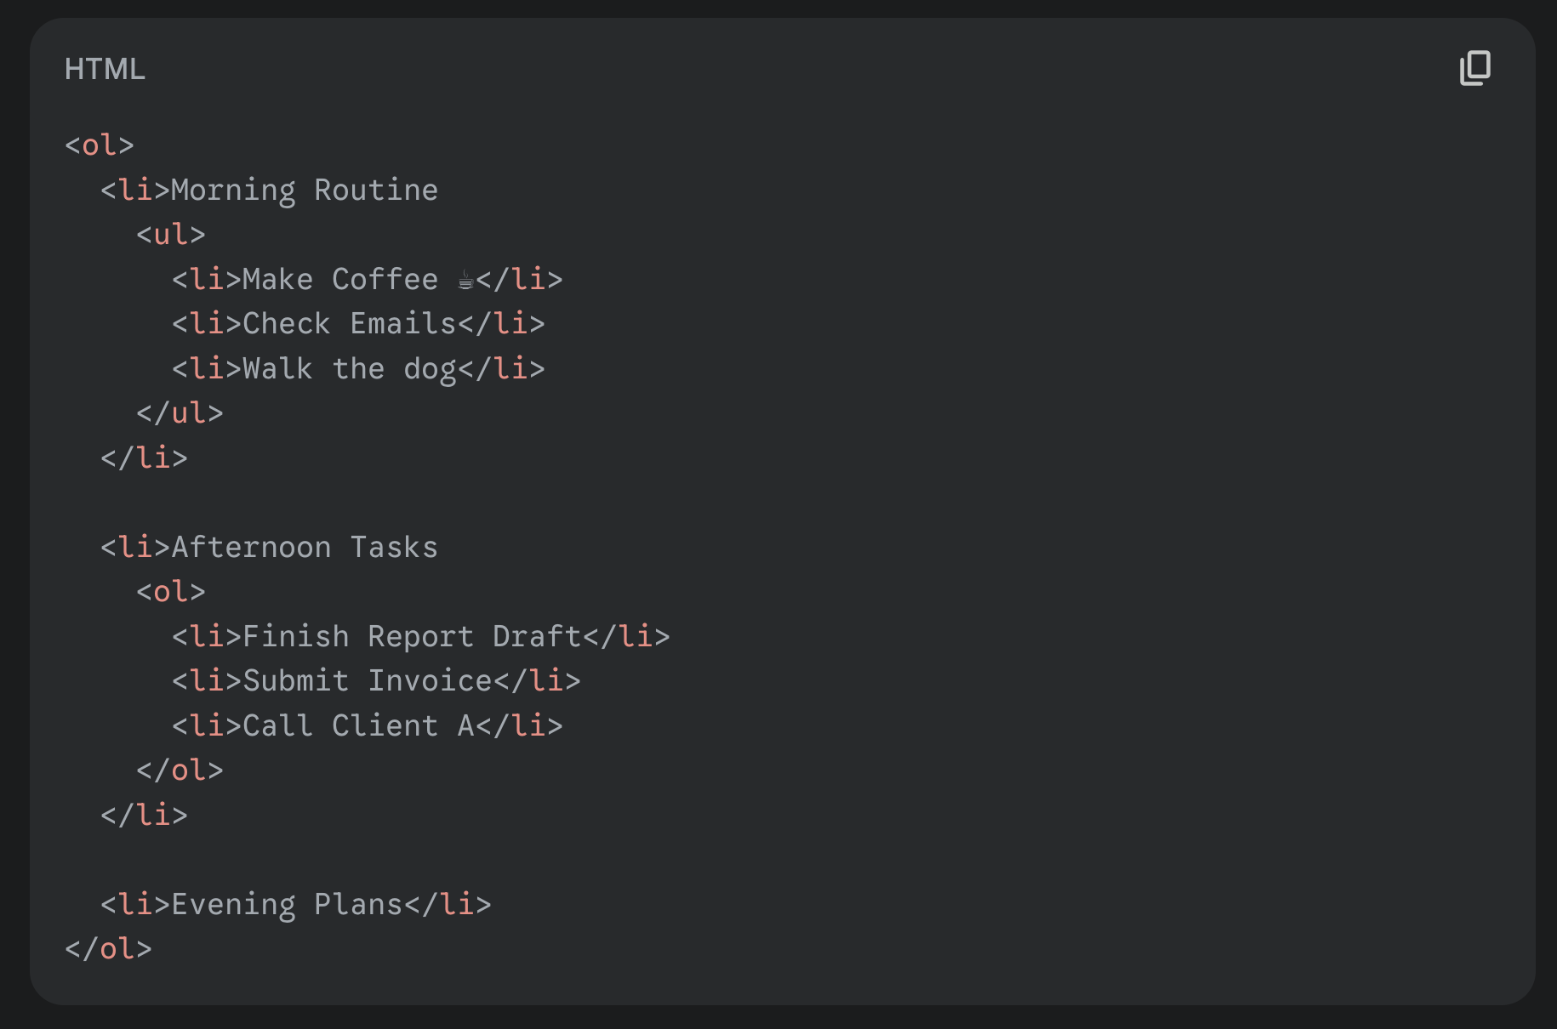
Lists:
<ul> element :
displays items with bullets and order doesn’t matter.
Its attributes:
Type: bullet style (disc , circle , square)
Important: you can put lists inside other list :

Slide 17
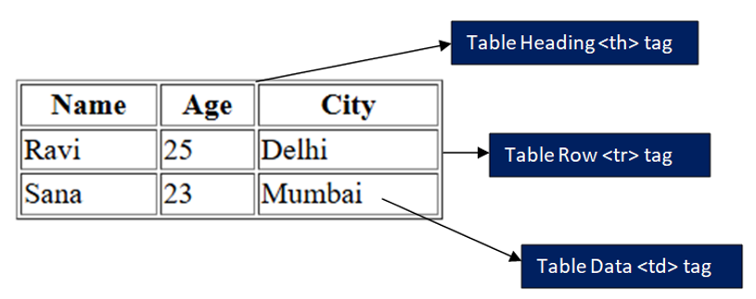
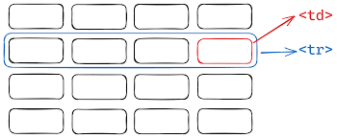
Table:
A table organize data into rows <tr> and columns <td / th> element.
<table></table> tag is a container for entire element .
Structural Grouping Elements:
<thead>: Groups the introductory content or column labels of a table.
<tbody>: Groups the main data content (the body) of the table.
<tfoot> : Groups the summary rows of a table, such as totals, averages, or final notes.
Groups the main data content (the body) of the table.
Table elements:
1. <tr> (Table Row)
Defines a single row within a table.
2. <td> (Table Data Cell)
Defines a standard data cell (a column) within a table row.
3. <th> (Table Header Cell)
Defines a cell that acts as a header (a title or label) for a row or column of data.

Slide 18
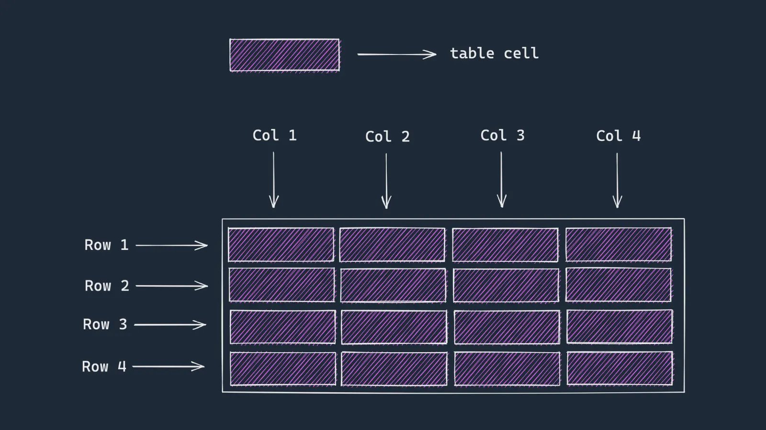

Slide 19
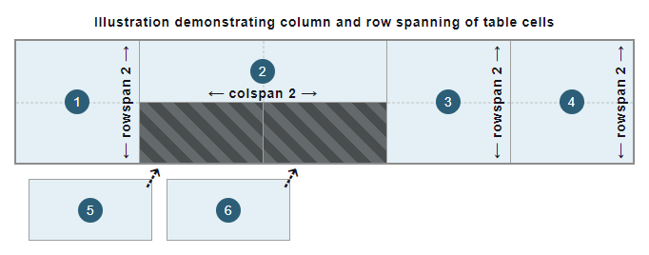
Table attributes:
1- Rowspan : merge rows each other
2- Colspan: merge columns each other.

